Slide 1

Sentiment Analysis of Yelp’s Businesses Reviews, And User Data" Using 3-NF
PRESENTERS:
Naveen Varma Pandeti
Sumanth reddy busireddy
Sri swetha

Slide 2

What is Yelp?
popular online directory of local businesses from various industries
The idea behind Yelp is for users to leave their rating and a review of their experience with an establishment.
Yelp reviews can be used to gain insights into customer experiences, identify areas for improvement, and gauge customer sentiment towards the business.

Slide 3

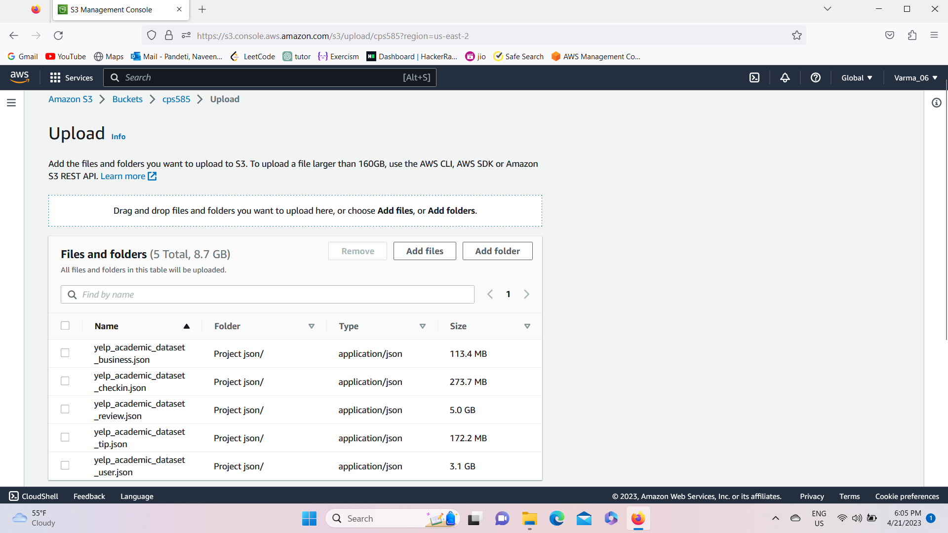
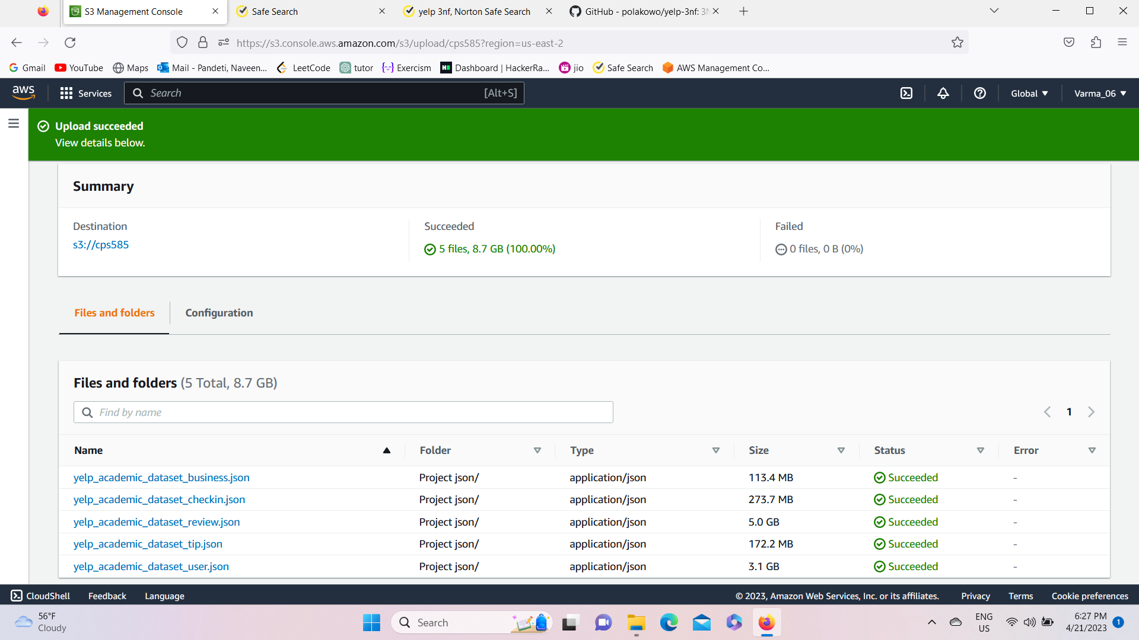
Project Development
Load to S3 (bucket)
We have Suscessfully Created S3 bucket and loaded the JSON files in to it , that processes them, and stores their normalized and enriched versions back into S3 in Parquet format. After this, Redshift takes over and copies the tables into a DWH.
Here, All three datasets reside in a Amazon S3 bucket, which is the easiest and safest option to store and retrieve any amount of data at any time from any other AWS service.

Slide 4
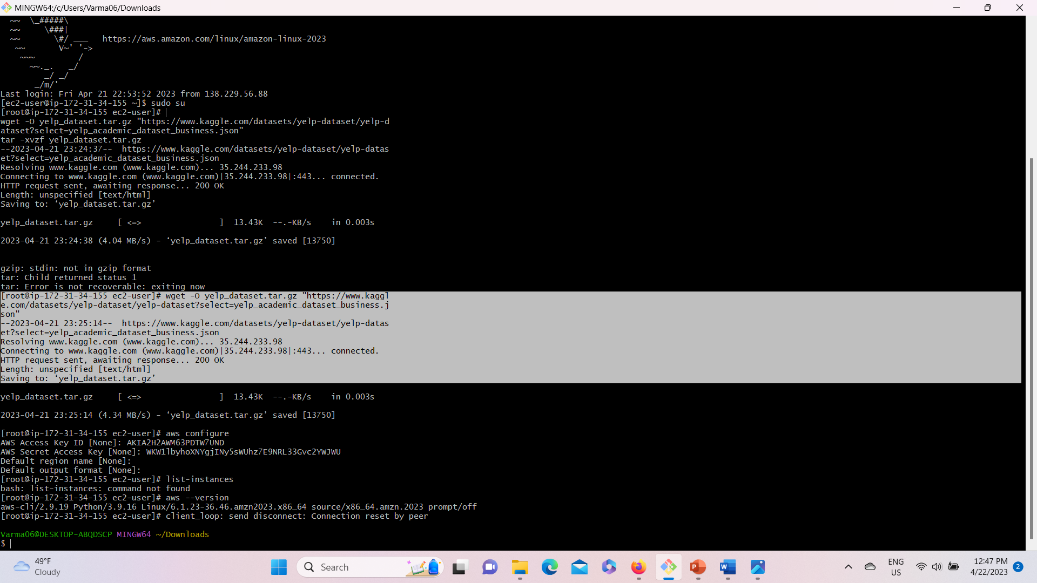
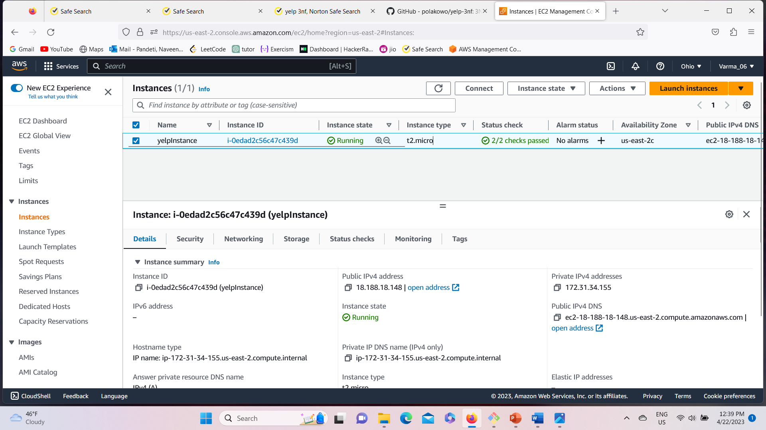



Creating a linux instance(VM)
Created a EC2 Linux instance and connected to the instance through the terminal called Gitbash. As it is a linux machine the ssh port 22 should be enabled in the security group of that instance.
Uploaded all the JSON files to the linux instance through wget command. All the files are successfully uploaded to the instance as shown in the above screenshot.

Slide 5
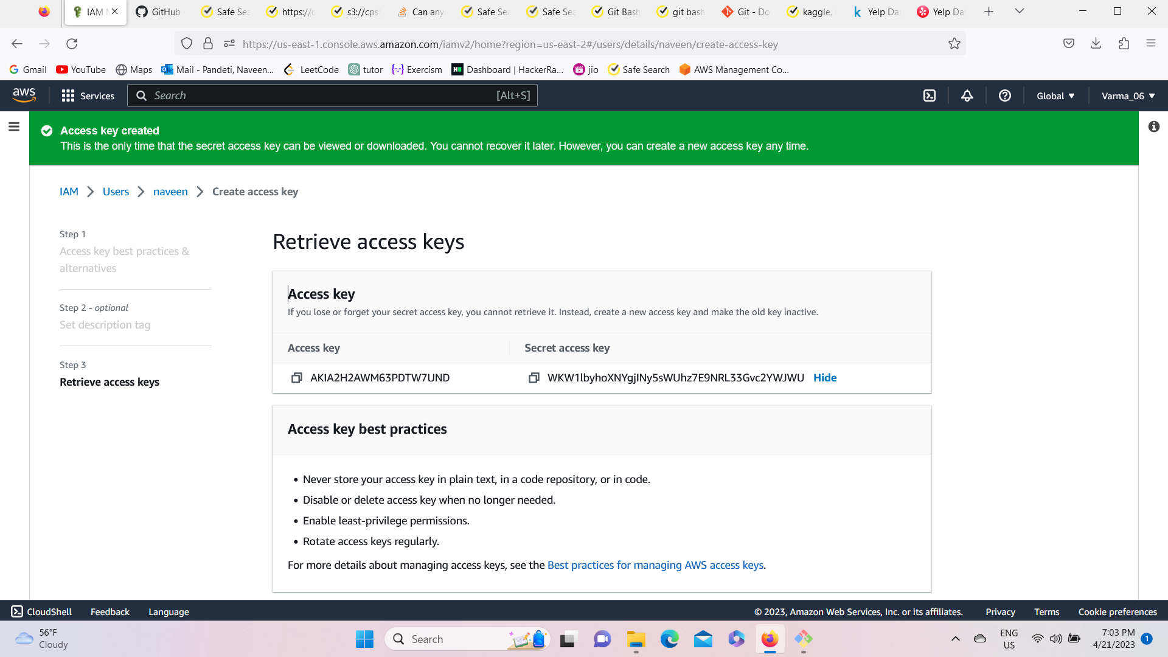
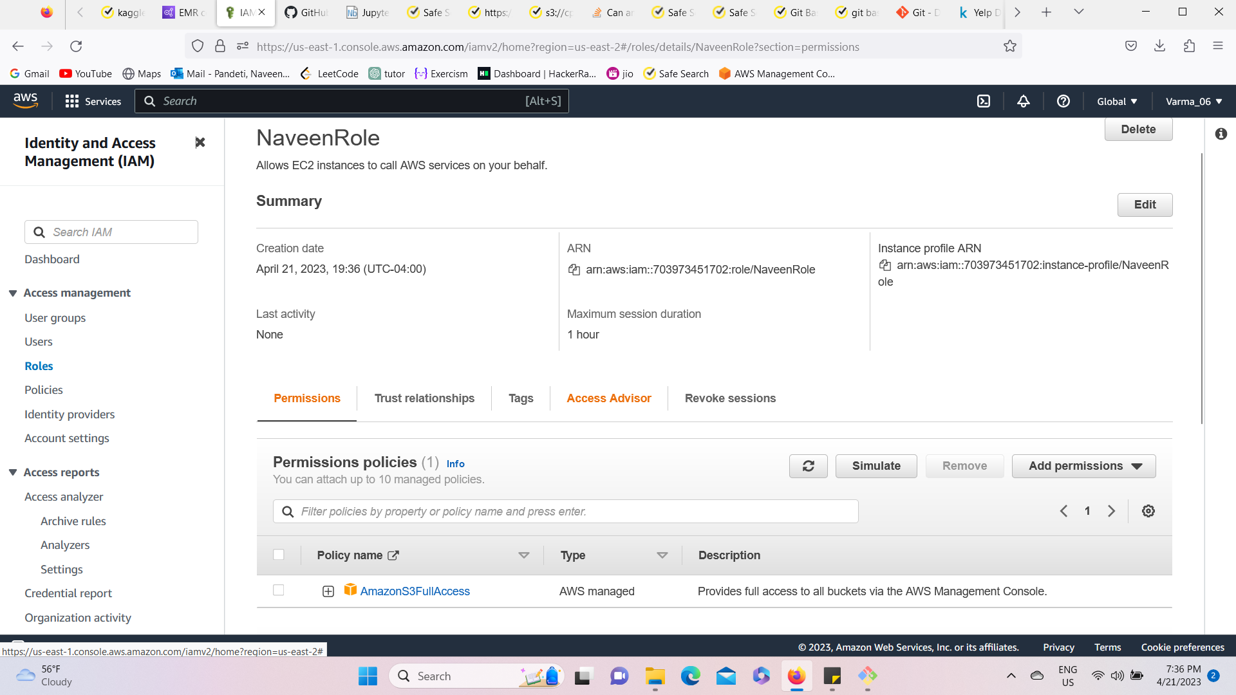
Created a IAM user & role and attached the role to the instance
Created IAM user(naveen) with Amazon S3FullAccess. Generated Access key and secret key to login to Aws through AWS CLI.
Created the IAM Role with AmazonS3FullAccess and attached that role to the EC2 instance. So that the users who login to that instance have also permissions to do anything with S3 buckets as well.
For example, you can use IAM roles to grant permissions to applications running on your instances that need to use a bucket in Amazon S3. You can specify permissions for IAM roles by creating a policy in JSON format. These are similar to the policies that you create for users. If you change a role, the change is propagated to all instances.
When creating IAM roles, associate least privilege IAM policies that restrict access to the specific API calls the application requires.

Slide 6
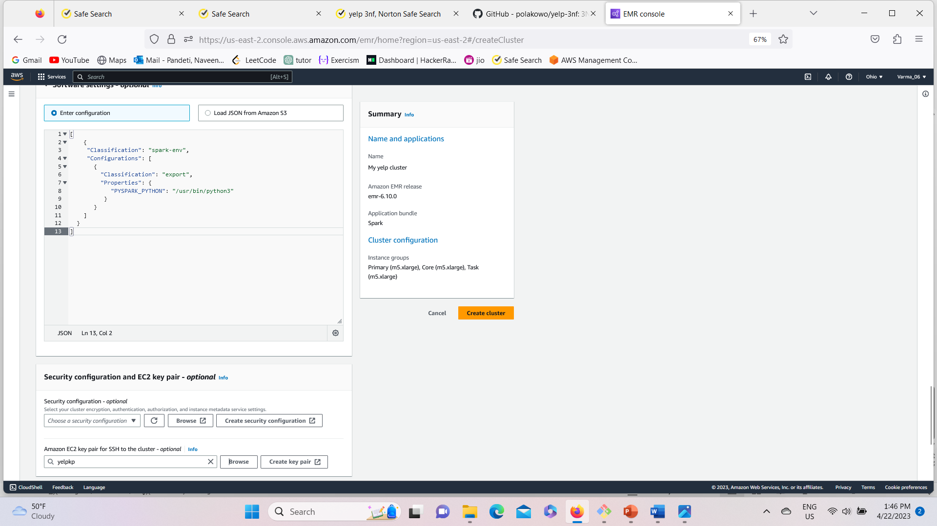
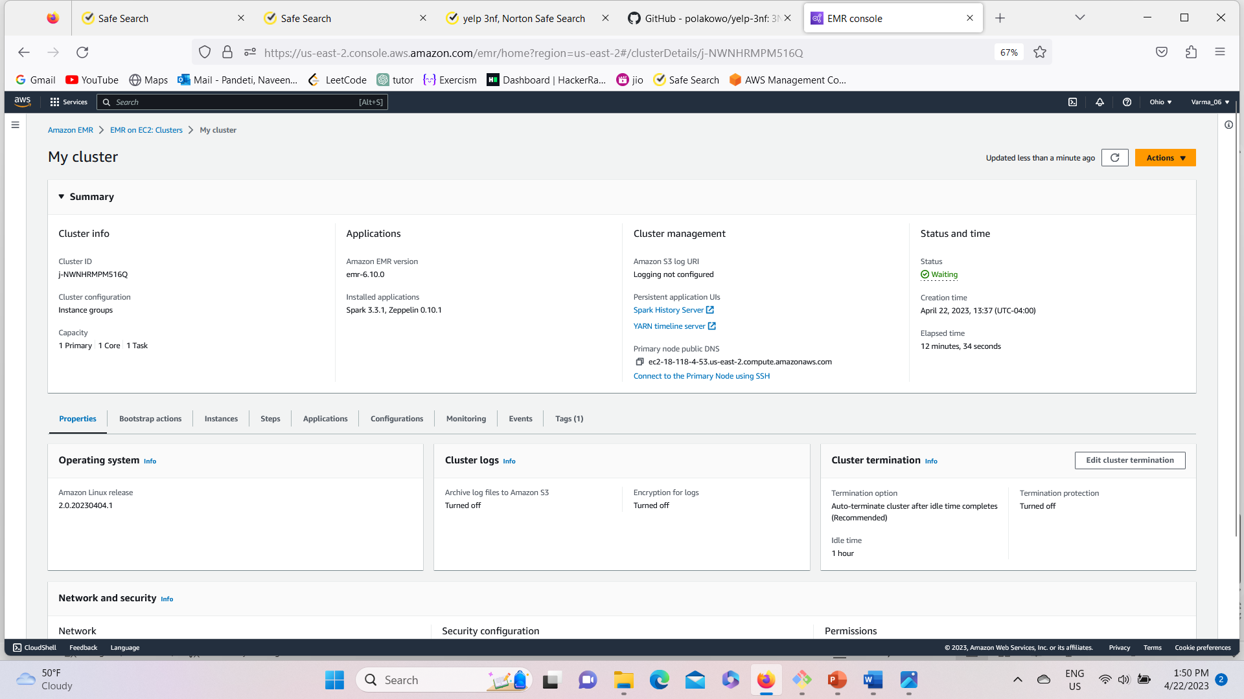
Amazon EMR Cluster creation
Created EAM cluster with Spark application and with providing the configuration JSON to make Python 3 default
While creating the cluster we need to attach the IAM role as well as EC2 instances so that they are interlinked.
Needs to enable the port 8998 in the security group of the EC2 instances that is attatched to the cluster. So that we can access the cluster through the EC2 instance.
NOTE: EAM cluster should be created in the same region as the IAM Role and EC2 Instance.

Slide 7
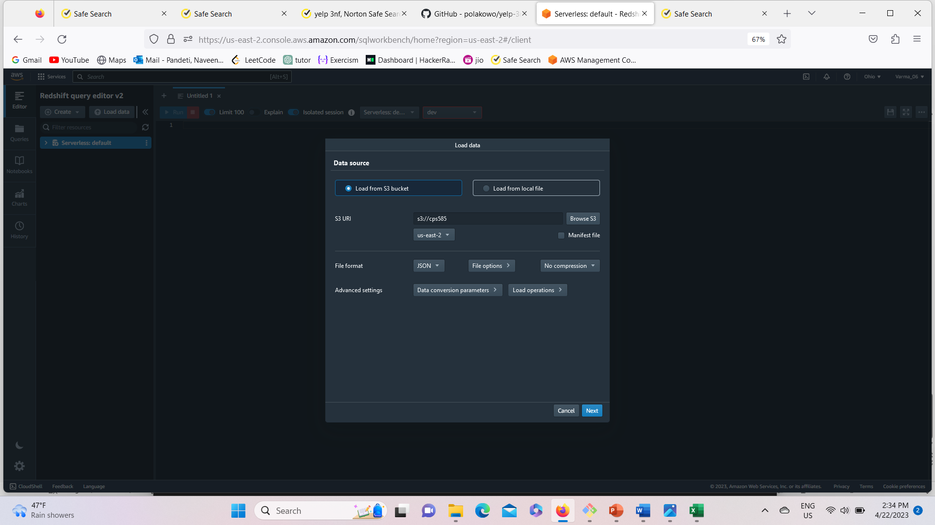
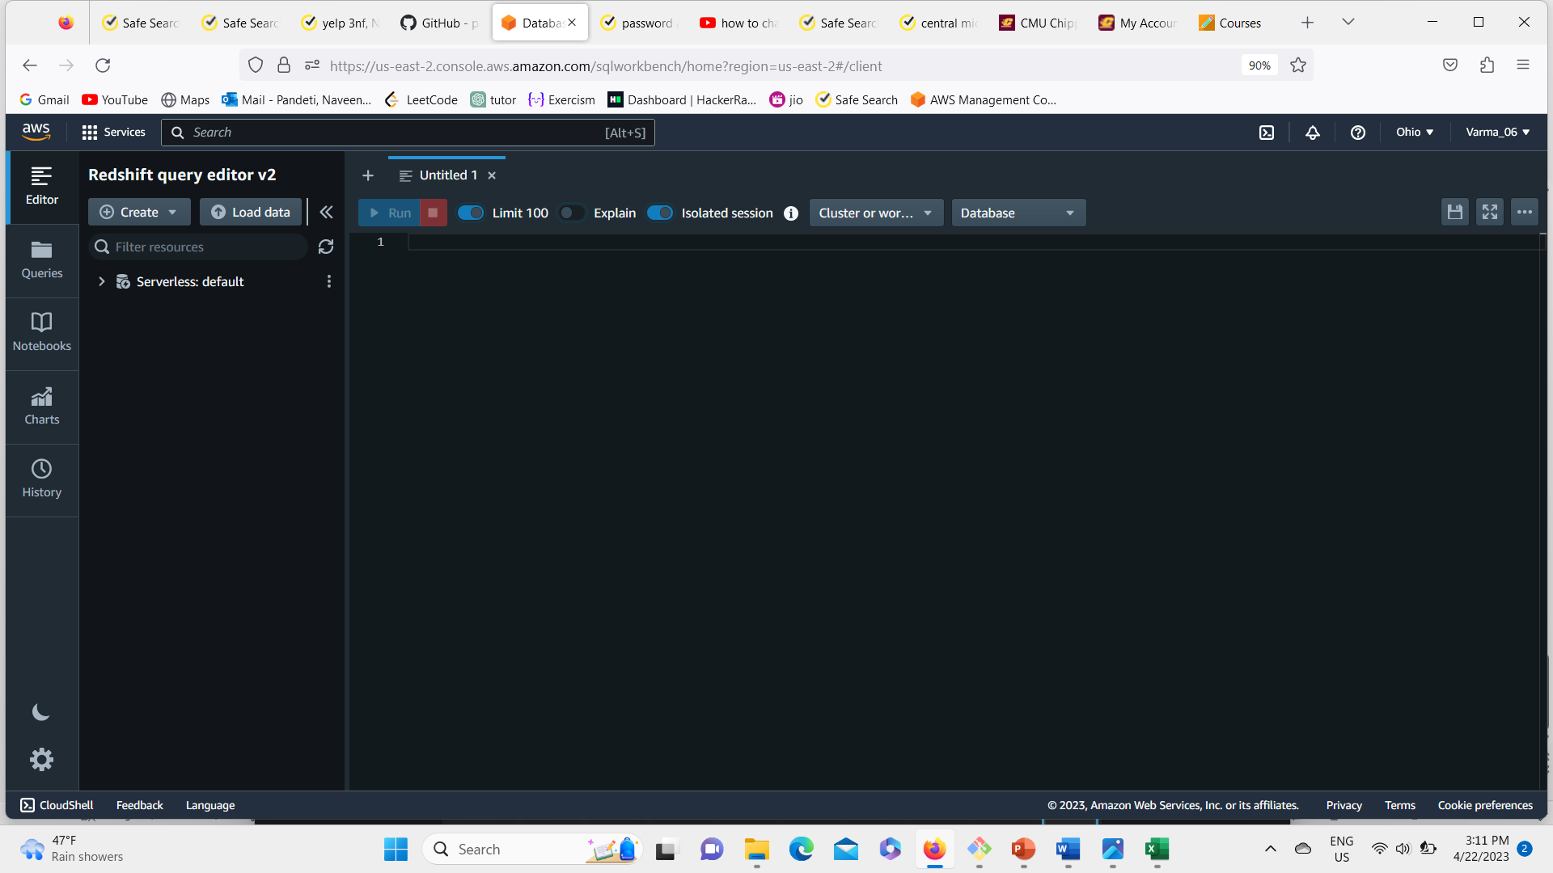
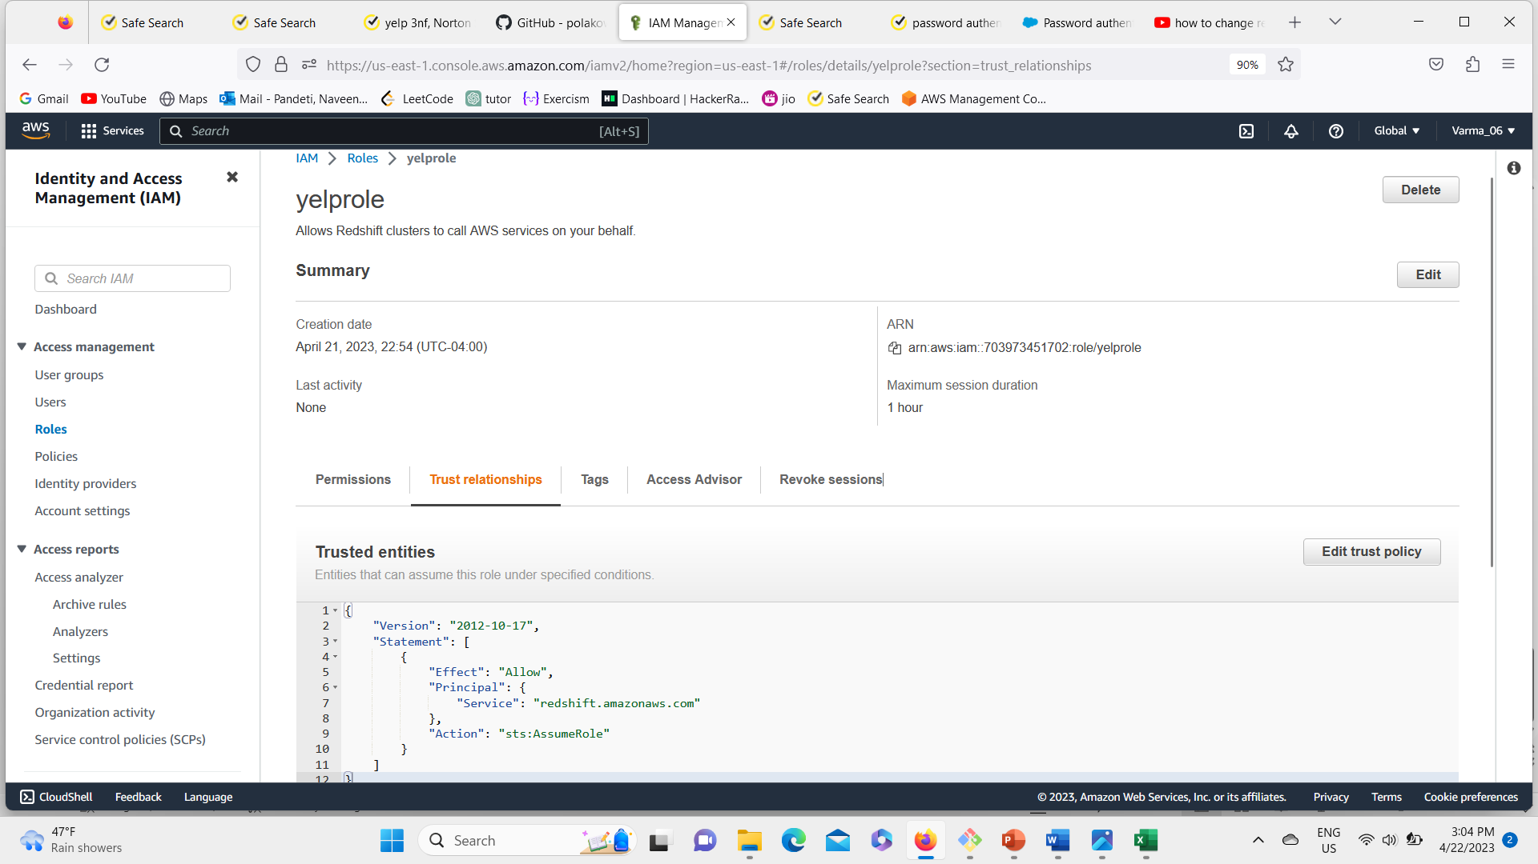
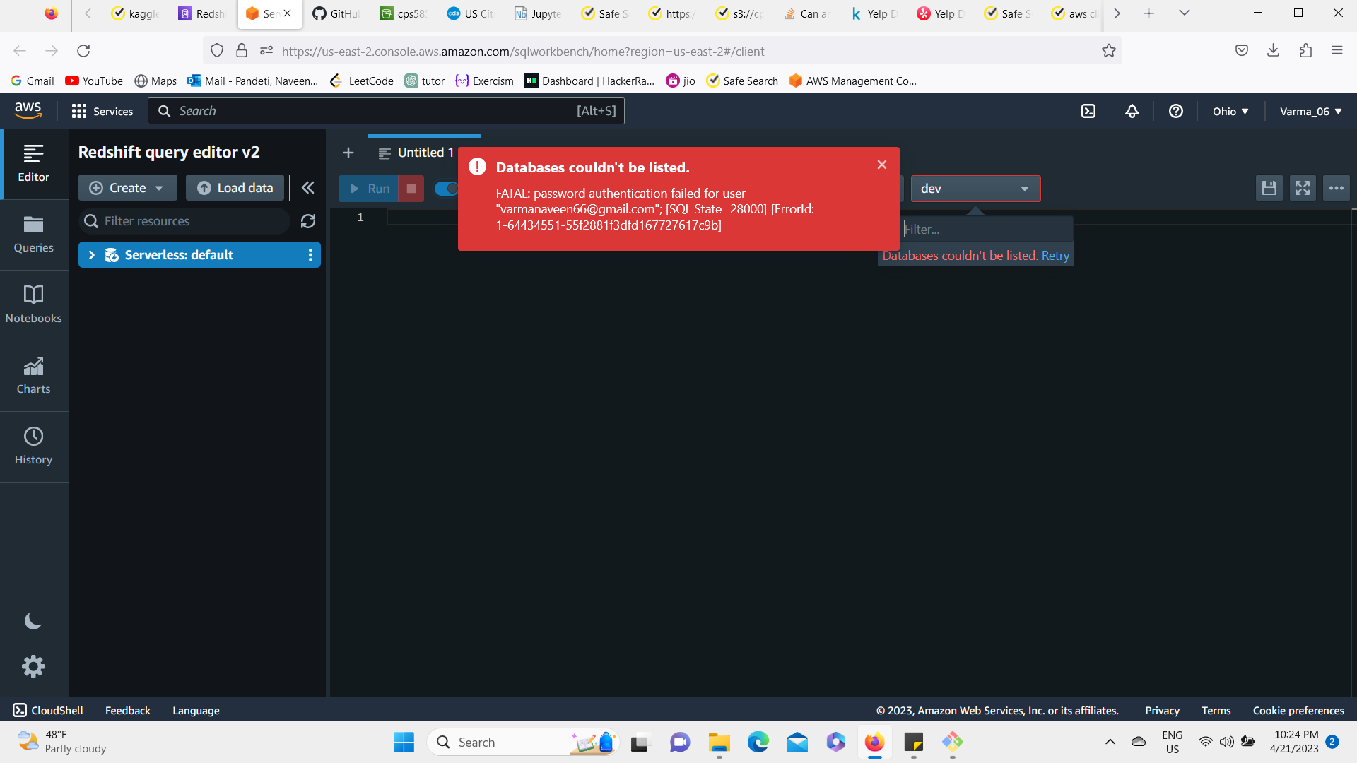
Loading data from S3 to redshift
Redshift – serverless DB
Redshift cluster – suscessfully created
Error : working on it / !
Error overview : Our redshift serverless data base is not accepting case sensitive Passcode,
so we are changing the credentials for IAM root user - So we can access AWS – SDB / ( dwh).

Slide 8
Yet to implement :
< > Redshift should extract data from our pipeline (S3 bucket) then the data in redshift needs to get access from Amazom airflow to execute our project (i.e final transformation of loaded data )
Challenges that we have observed: (so far…..)
#1 : While Loading large volumes of data into Redshift I felt like it might be time-consuming and may require tuning of the Redshift cluster to optimize performance.
#2 : When we are Transforming the data from its original format to 3NF can be challenging, especially when dealing with nested data structures. It requires a thorough understanding of the schema and a good knowledge of data processing tools like Spark.
Thank you

